Slide 1
Legislative / Regulatory / Political
Update
By Michael T. Oscar
Director of Government Relations
American Subcontractors Association
American Subcontractors Association
1004 Duke St., Alexandria, VA 22314
www.asaonline.com | www.subexcel.com | http://contractorscompass.org

Slide 2
American Subcontractors Association
1004 Duke St., Alexandria, VA 22314
www.asaonline.com | www.subexcel.com | http://contractorscompass.org

Slide 3
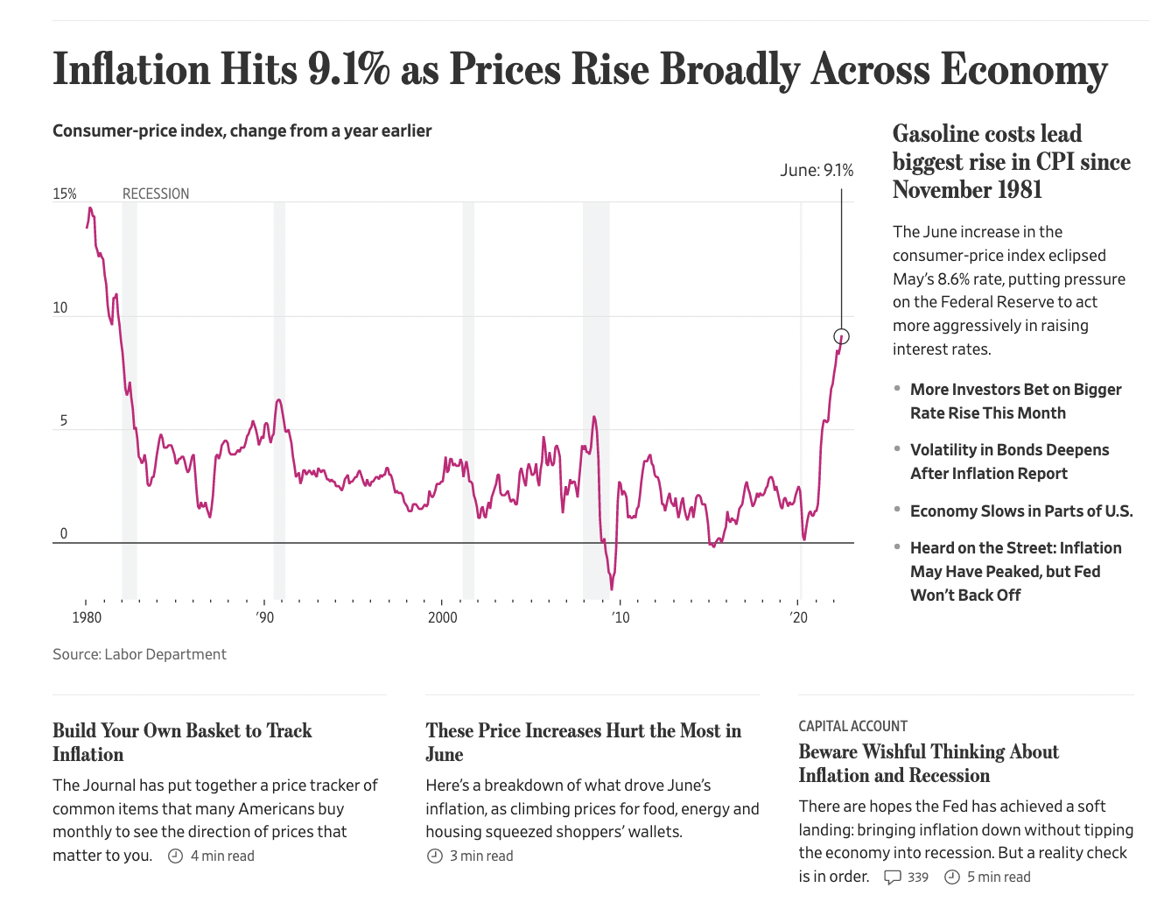
American Subcontractors Association
1004 Duke St., Alexandria, VA 22314
www.asaonline.com | www.subexcel.com | http://contractorscompass.org

Slide 4
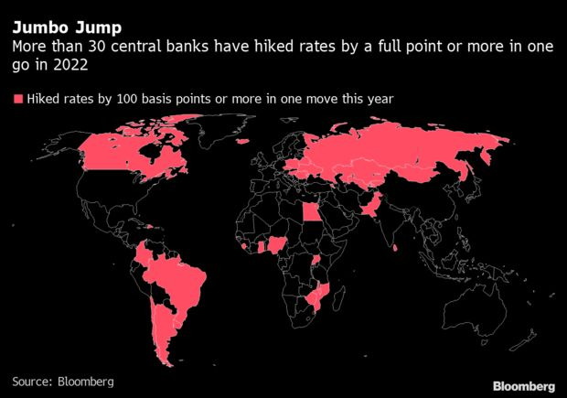
American Subcontractors Association
1004 Duke St., Alexandria, VA 22314
www.asaonline.com | www.subexcel.com | http://contractorscompass.org

Slide 5
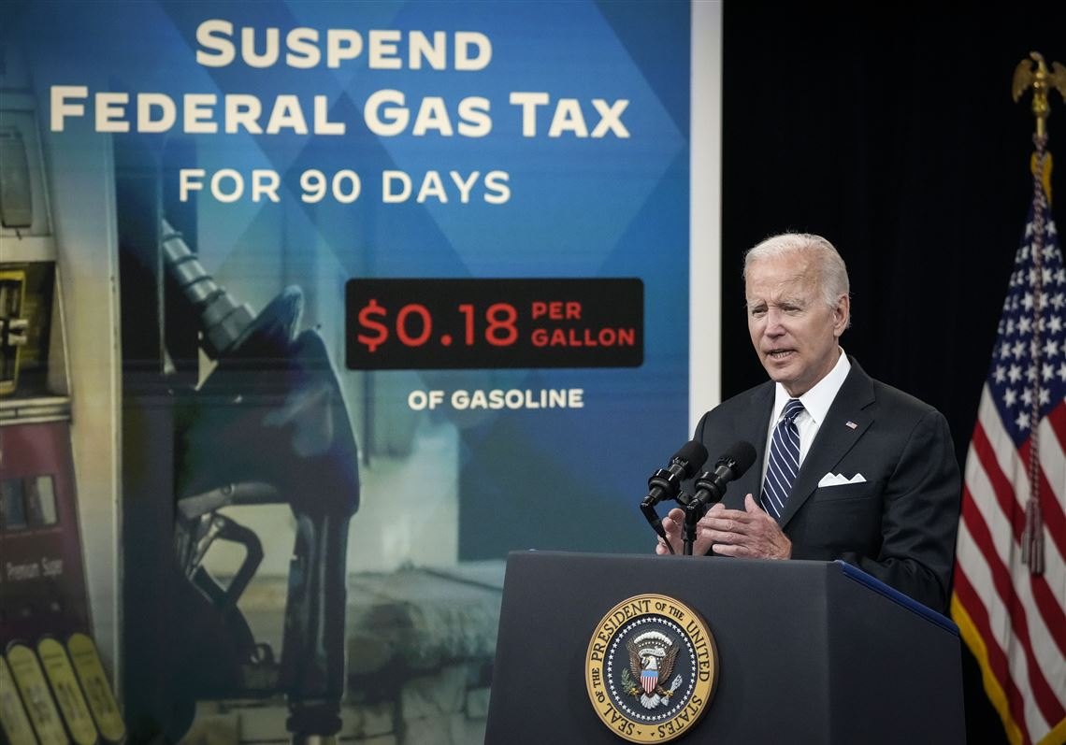
ASA Opposes this Suspension
American Subcontractors Association
1004 Duke St., Alexandria, VA 22314
www.asaonline.com | www.subexcel.com | http://contractorscompass.org

Slide 6
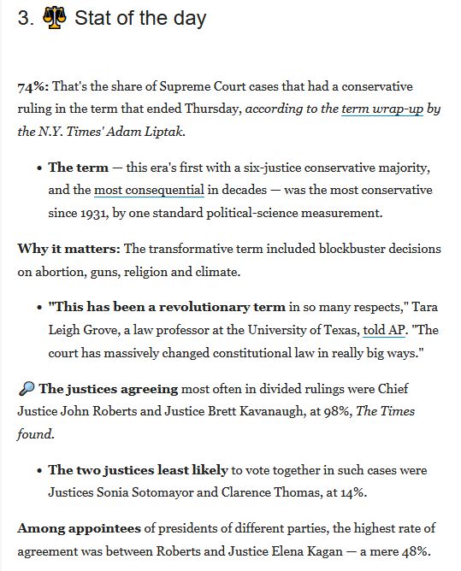
RECENT SCOTUS RULINGS
American Subcontractors Association
1004 Duke St., Alexandria, VA 22314
www.asaonline.com | www.subexcel.com | http://contractorscompass.org

Slide 7
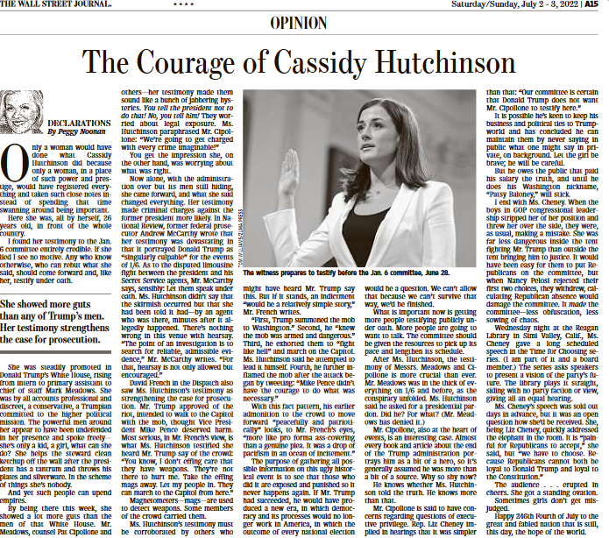
American Subcontractors Association
1004 Duke St., Alexandria, VA 22314
www.asaonline.com | www.subexcel.com | http://contractorscompass.org

Slide 8
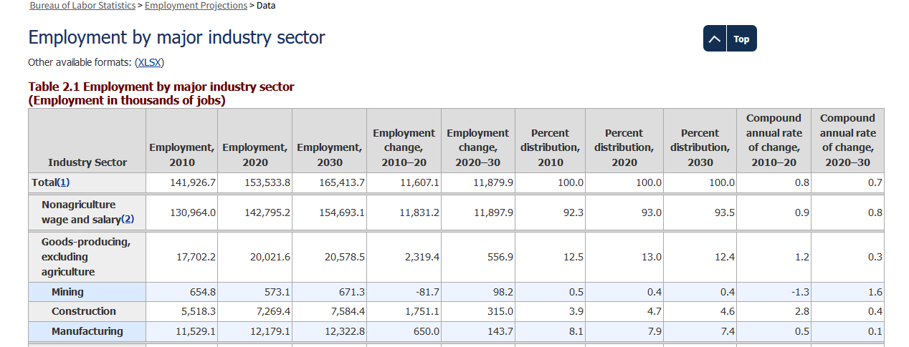
Bureau of Labor Statistics: Construction
American Subcontractors Association
1004 Duke St., Alexandria, VA 22314
www.asaonline.com | www.subexcel.com | http://contractorscompass.org

Slide 9
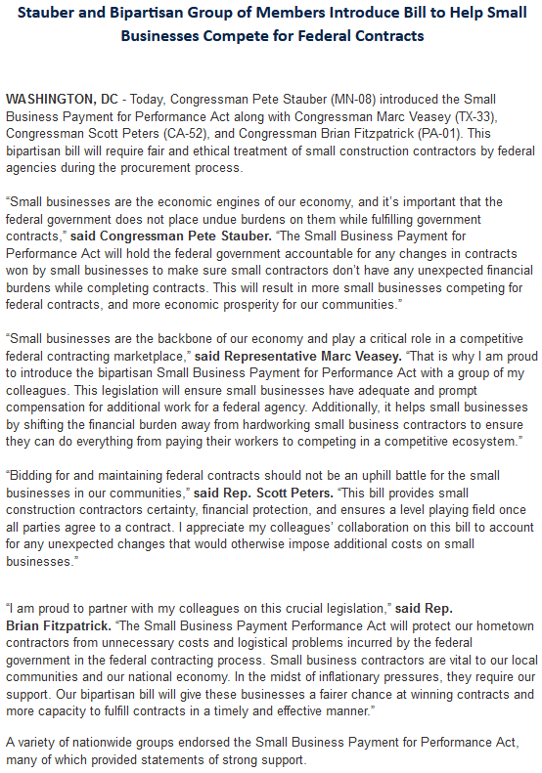
ASA Sponsored Legislation Introduced 7/1/22
American Subcontractors Association
1004 Duke St., Alexandria, VA 22314
www.asaonline.com | www.subexcel.com | http://contractorscompass.org

Slide 10
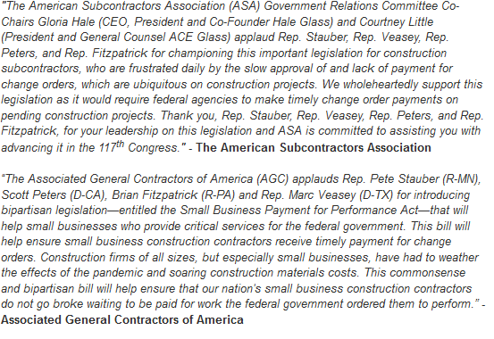
ASA Sponsored Legislation Introduced 7/1/22
American Subcontractors Association
1004 Duke St., Alexandria, VA 22314
www.asaonline.com | www.subexcel.com | http://contractorscompass.org

Slide 11
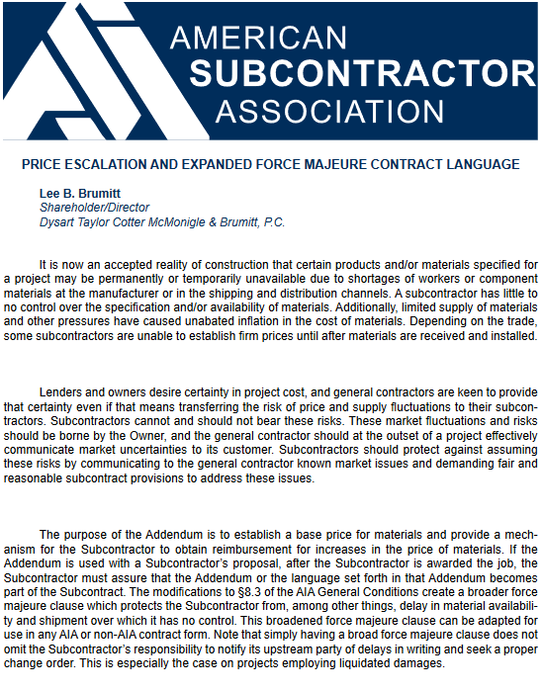
American Subcontractors Association
1004 Duke St., Alexandria, VA 22314
www.asaonline.com | www.subexcel.com | http://contractorscompass.org

Slide 12
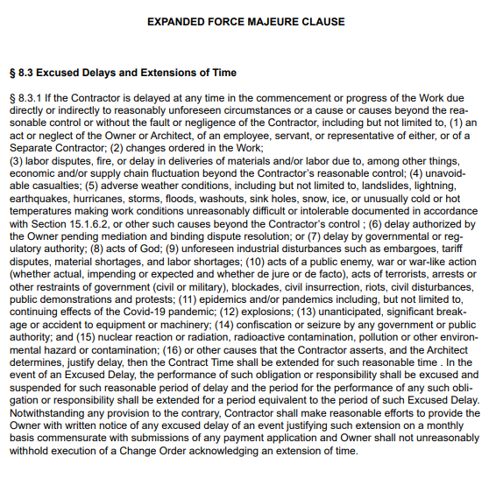
American Subcontractors Association
1004 Duke St., Alexandria, VA 22314
www.asaonline.com | www.subexcel.com | http://contractorscompass.org

Slide 13
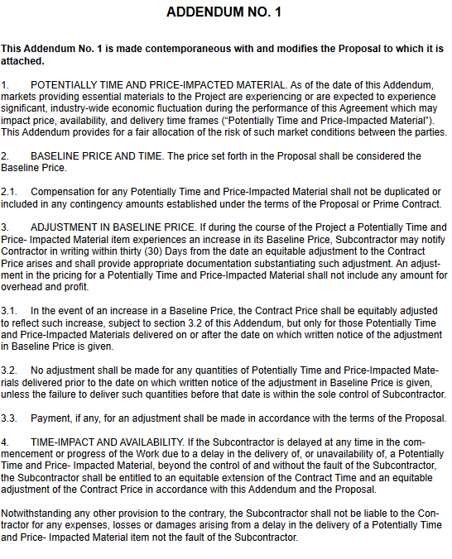
American Subcontractors Association
1004 Duke St., Alexandria, VA 22314
www.asaonline.com | www.subexcel.com | http://contractorscompass.org

Slide 14
2022 Election
American Subcontractors Association
1004 Duke St., Alexandria, VA 22314
www.asaonline.com | www.subexcel.com | http://contractorscompass.org

Slide 15
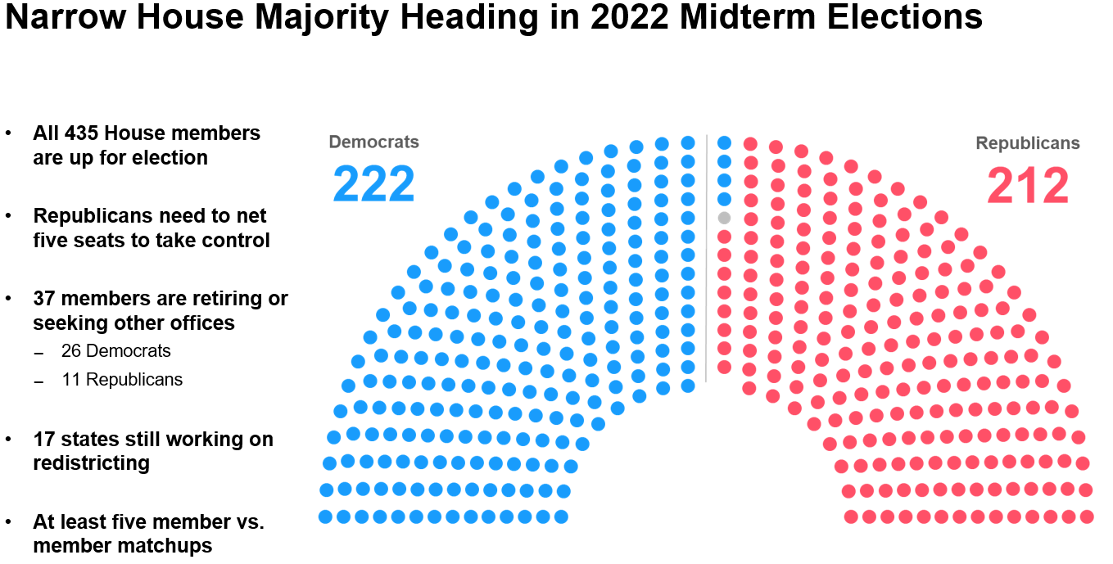
American Subcontractors Association
www.asaonline.com | www.subexcel.com | http://contractorscompass.org

Slide 16
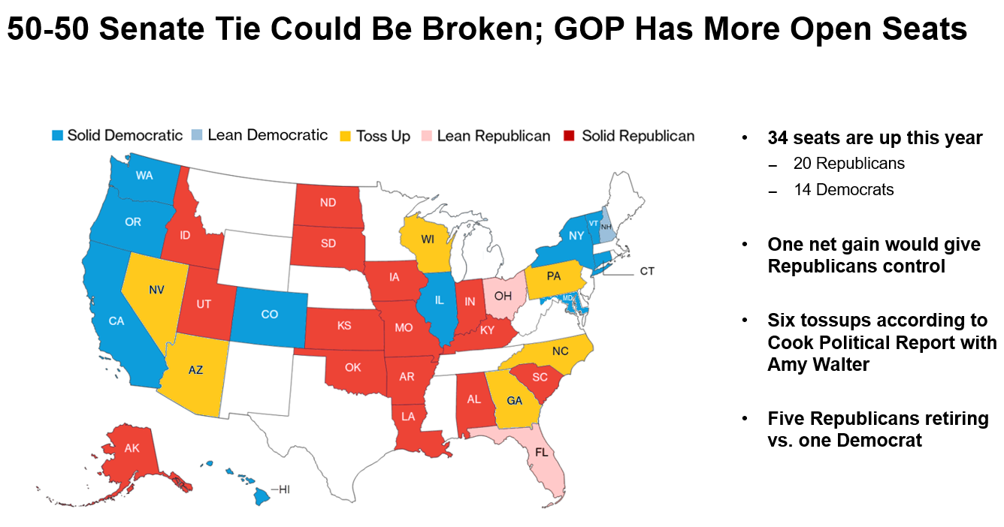
American Subcontractors Association
www.asaonline.com | www.subexcel.com | http://contractorscompass.org

Slide 17
117th Congress
ASA Guiding Principles:
Educate
Advocate
Promote Collaboration
Voice Support and/or Opposition to Policies that Impact the Subcontractor Community
American Subcontractors Association
www.asaonline.com | www.subexcel.com | http://contractorscompass.org

Slide 18
117th Congress
Workforce Development
Apprenticeship Funding Opportunities
Prevent the Misclassification of Employees as Independent Contractors
Federal Tax Reform
Make the Pass-Through Deduction Permanent to Ensure Certainty and Predictability
Maximize the Value and Integrity of the New Deduction for Pass-Through Businesses
Repeal the Estate Tax
Repeal the Alternative Minimum Tax Make Remaining Tax Extenders Permanent
Contracting Reform
Establish a statute of repose for federal construction projects
Ensure payment protections for construction subcontractors and suppliers performing federal construction under Public-Private Partnerships
Prohibit the utilization of reverse auctions for the procurement of construction contracts
Improve the design-build construction process
Ensure responsible contractors are given priority in the bidding process of federal contracts
American Subcontractors Association
www.asaonline.com | www.subexcel.com | http://contractorscompass.org

Slide 19
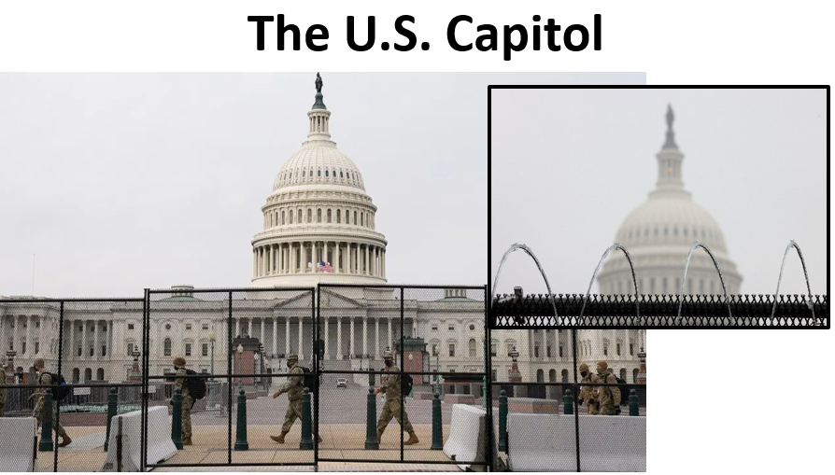
117th Congress
American Subcontractors Association
www.asaonline.com | www.subexcel.com | http://contractorscompass.org

Slide 20
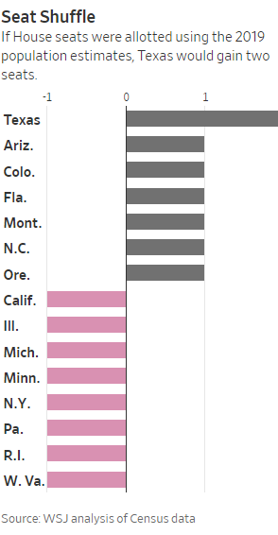
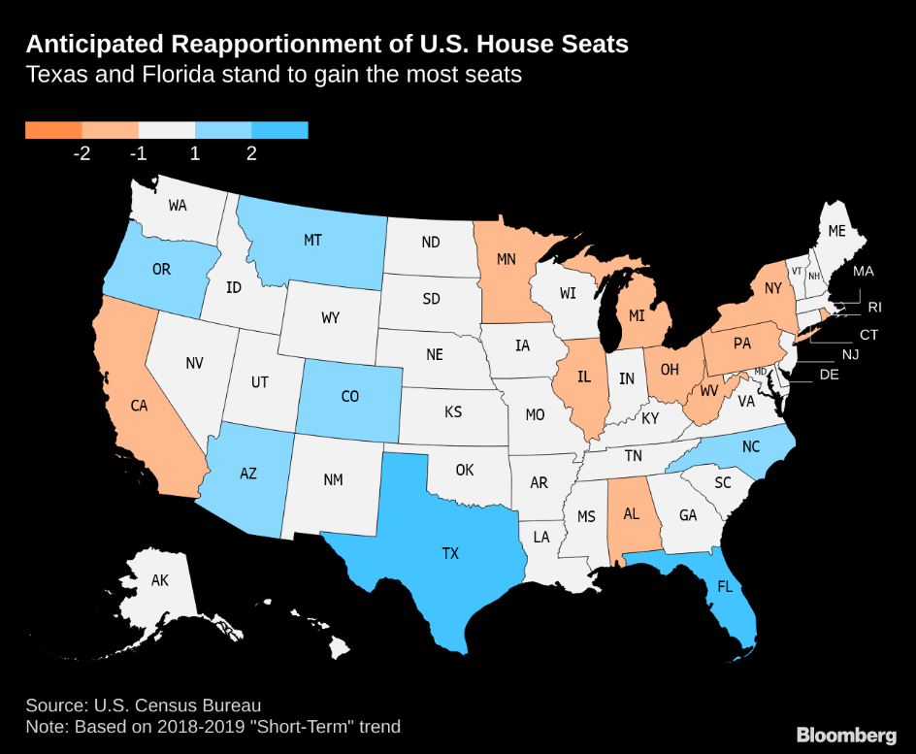
Population Shift Helps South and Southwest
Texas, Florida and North Carolina will likely gain House seats in the 2022 elections, while Michigan, Ohio and Pennsylvania will continue to lose political clout:
17 states’ representation may be affected by the once-a-decade census
Continues decades-long trend of the South and West expanding more California, projected to lose one of its 53 seats, would lose House seat for first time
Florida is projected to have a larger delegation (29) than New York (26)
Reapportionment would be released after the census and in effect for 2022 elections
American Subcontractors Association
www.asaonline.com | www.subexcel.com | http://contractorscompass.org

Slide 21
ASA Task Force on Government Advocacy
American Subcontractors Association
1004 Duke St., Alexandria, VA 22314
www.asaonline.com | www.subexcel.com | http://contractorscompass.org

Slide 22
2021 Legislative Priorities
Senate Infrastructure Package Passes 69-29
H.R. 26 – Technical Corrections to Ban on Reverse Auctions Becomes Law 7/26/21
H.R. 2949 – Exemption of Increases to the Miller Act Bond Threshold
H.R. 1641, S. 638 – P3 Bonding Surface Transportation Requirements
Educating the House Construction Procurement Caucus
American Subcontractors Association
1004 Duke St., Alexandria, VA 22314
www.asaonline.com | www.subexcel.com | http://contractorscompass.org

Slide 23
2022 Legislative Priorities
Implementation of infrastructure package
Price Escalation in federal contracts
Introduction of Comprehensive Federal Procurement Legislation: change order and statute of repose reform, and pre bid transparency in federal contracts
P3 Bonding Water Transportation Projects
Federal SBA Bonding Retainage Reform
American Subcontractors Association
1004 Duke St., Alexandria, VA 22314
www.asaonline.com | www.subexcel.com | http://contractorscompass.org

Slide 24
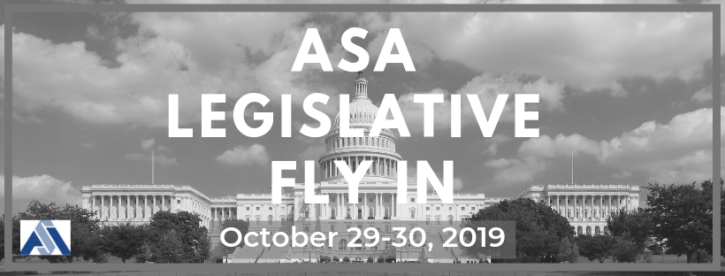
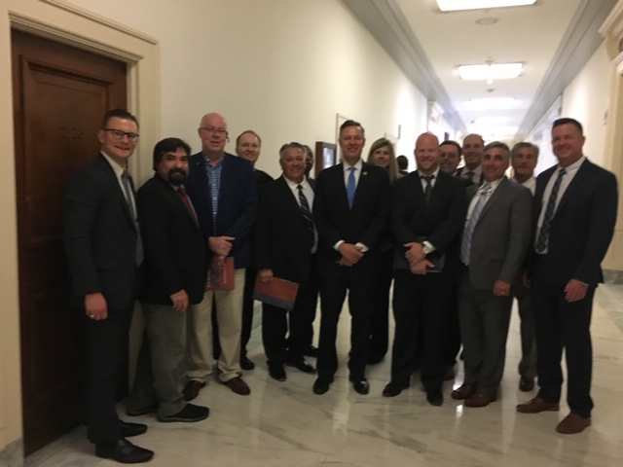

Slide 25
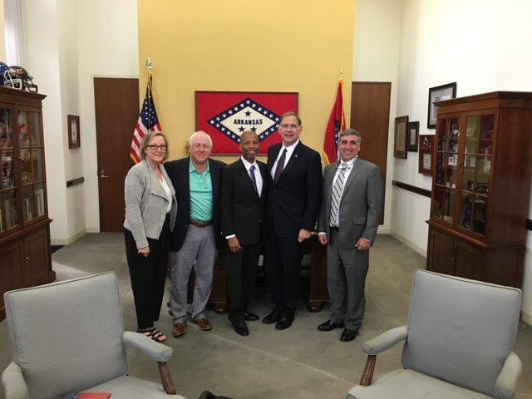

Slide 26
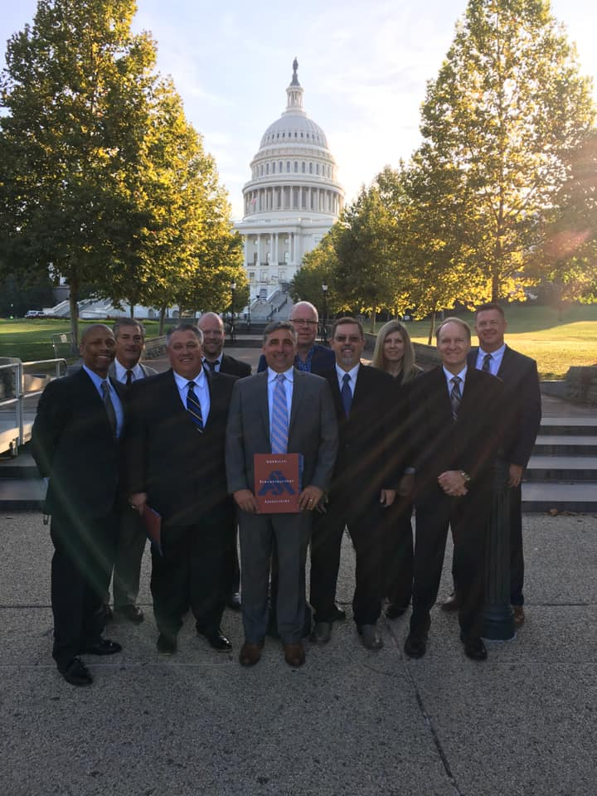
2023 Legislative Fly-In June 13-15, 2023
American Subcontractors Association
www.asaonline.com | www.subexcel.com | http://contractorscompass.org

Slide 27
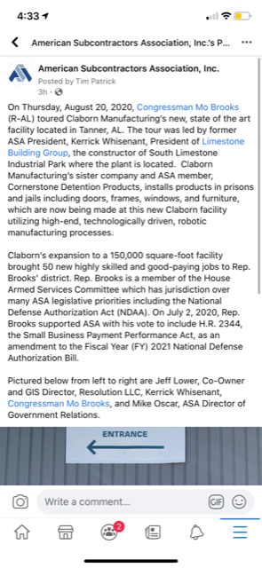
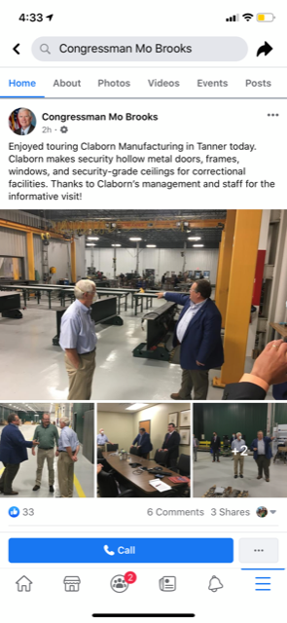
ASA Member, Kerrick Whisenant, hosts Rep. Brooks (R-AL) on August 20, 2020 to discuss the unfair competition practices on the construction by the Federal Prison Industries.
NOTE: Over 2,000 ASA Members viewed these posts.
2021 Legislative Fly-In
American Subcontractors Association
www.asaonline.com | www.subexcel.com | http://contractorscompass.org

Slide 28
Regulatory Update
American Subcontractors Association
1004 Duke St., Alexandria, VA 22314
www.asaonline.com | www.subexcel.com | http://contractorscompass.org

Slide 29
Regulatory Update
Vaccine Mandates (OSHA and Federal)
EPA HBCD Rulemaking
Hexabromocylcododecane (HBCD), a flame retardant in expanded polystyrene and extruded polystyrenein insulation foam used for construction
OSHA Heat and Injury Illness Prevention Rule
DOL’s Davis Bacon Proposed Rule
SBA Surety Bond Guarantee Program
On February 5, 2021, ASA commented on FAR Council Reverse Auction Regulation
OSHA issued new enforcement guidance on exposure to beryllium dust
American Subcontractors Association
1004 Duke St., Alexandria, VA 22314
www.asaonline.com | www.subexcel.com | http://contractorscompass.org

Slide 30
State Chapter Engagement
American Subcontractors Association
1004 Duke St., Alexandria, VA 22314
www.asaonline.com | www.subexcel.com | http://contractorscompass.org

Slide 31
State Chapter Engagement
GRC Presentations:
ASA Carolinas Convention
ASA Central PA
ASA New Mexico
ASA Utah
ASA San Antonio
ASA Southwest Florida Chapter
ASA Michigan
ASA Colorado
ASA Houston
ASA Baton Rouge
State Issues of Concern:
ASA Southwest Florida – Retainage
ASA Colorado – Retainage
ASA Baton Rouge – PACE (Alternative Energy Financing)
ASA Central PA and Western PA – Anti-indemnification
ASA New Mexico – Workers Compensation
ASA DC Metro / Baltimore – P3s Projects and Retainage
American Subcontractors Association
1004 Duke St., Alexandria, VA 22314
www.asaonline.com | www.subexcel.com | http://contractorscompass.org

Slide 32
State Chapter Engagement Voter Voice: Three Campaigns (OK, CO, DC Metro) = 109 ASA Participants sent 1,189 messages

Slide 33
State Chapter Engagement
Podcasts / Webinars
Two Podcasts for Women in Construction Month (3/21)
MO interviews Shelia Ohrenberg and Dana Thompson (Women in Construction Coalition)
SO interviews Bethany Beck (ASA AC Chair)
Podcast with Jordan Howard, AGC’s Director of Federal & Heavy Construction, on May 20, 2021
Podcast with Dalton Defendis, the Surety&Fidelity Association of America’s GRC Director, on July 28, 2021
Podcast on H2K Oklahoma SLDF Case on September 28, 2021
American Subcontractors Association
1004 Duke St., Alexandria, VA 22314
www.asaonline.com | www.subexcel.com | http://contractorscompass.org
Podcasts / Webinars
Two Podcasts for Women in Construction Month (3/21)
MO interviews Shelia Ohrenberg and Dana Thompson (Women in Construction Coalition)
SO interviews Bethany Beck (ASA AC Chair)
Podcast with Jordan Howard, AGC’s Director of Federal & Heavy Construction, on May 20, 2021
Podcast with Dalton Defendis, the Surety&Fidelity Association of America’s GRC Director, on July 28, 2021
Podcast on H2K Oklahoma SLDF Case on September 28, 2021

Slide 34
Attorney’s Council
Subcontractor Legal Defense Fund
American Subcontractors Association
1004 Duke St., Alexandria, VA 22314
www.asaonline.com | www.subexcel.com | http://contractorscompass.org

Slide 35
Attorney’s Council
Our Attorneys’ Council Members are regular presenters and contributors for ASA webinars, podcasts and member resources and we are grateful for their participation and contributions.
ASA Resource Document Projects
ASA Subcontract Document Suite and Subcontractor Negotiating Tips – updating of 2018 resource
Retainage Law in 50 States – updating of 2017 resource
Price Escalation and Force Majeure contract amendment resource
The group is always open to suggestions from members and Chapters on usual tools and education to be gleaned from our construction law attorneys in the Attorneys’ Council
American Subcontractors Association
1004 Duke St., Alexandria, VA 22314
www.asaonline.com | www.subexcel.com | http://contractorscompass.org

Slide 36
SLDF MISSION
ASA underwrites the legal costs of filing "friend-of-the-court" briefs to inform the Court regarding the broader impact of relevant construction industry cases throughout the country. We have won dozens of these cases since 1997, vindicating subcontractor rights today and into the future.
SINCE 1997

Slide 37
SLDF FUNDS RAISED FY22
$54,150
COVID PANDEMIC HAS SLOWED THE PACE OF CASES REACHING THE APPELLATE LEVEL
5 new cases reviewed
FUND SOURCES
VOLUNTARY CONTRIBUTIONS
VIRTUAL & IN-PERSON FUNDRAISING EVENTS
DIRECT DONOR APPEALS

Slide 38
Next Year Fundraising Plans:
Letter to previous donors
Fall Virtual Tasting Fundraiser
Fall Attorneys’ Council Fundraiser in coordination with ASA Baton Rouge Chapter
Annual SUBExcel Fundraiser

Slide 39
Thank You
Comments / Questions?
American Subcontractors Association
1004 Duke St., Alexandria, VA 22314
www.asaonline.com | www.subexcel.com | http://contractorscompass.org

