Slide 1
Legislative / Regulatory
Update
By Michael T. Oscar
Director of Government Relations
American Subcontractors Association
American Subcontractors Association
1004 Duke St., Alexandria, VA 22314
www.asaonline.com | www.subexcel.com | http://contractorscompass.org

Slide 2
State of Play
“Unlike in the past, where we were unified and drew in allies, currently our own commons seems to be breaking apart. What concerns me most as a military man is not our external adversaries; it is our internal divisiveness. We are dividing into hostile tribes cheering against each other, fueled by emotion and a mutual disdain that jeopardizes our future, instead of recovering our common ground and finding solutions.”
General Jim Mattis, former Defense Secretary, per his essay, “Duty, Democracy and the Threat of Tribalism.”
American Subcontractors Association
www.asaonline.com | www.subexcel.com | http://contractorscompass.org

Slide 3
116th Congress
American Subcontractors Association
1004 Duke St., Alexandria, VA 22314
www.asaonline.com | www.subexcel.com | http://contractorscompass.org

Slide 4
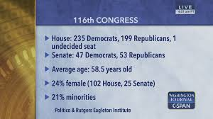
American Subcontractors Association
www.asaonline.com | www.subexcel.com | http://contractorscompass.org

Slide 5
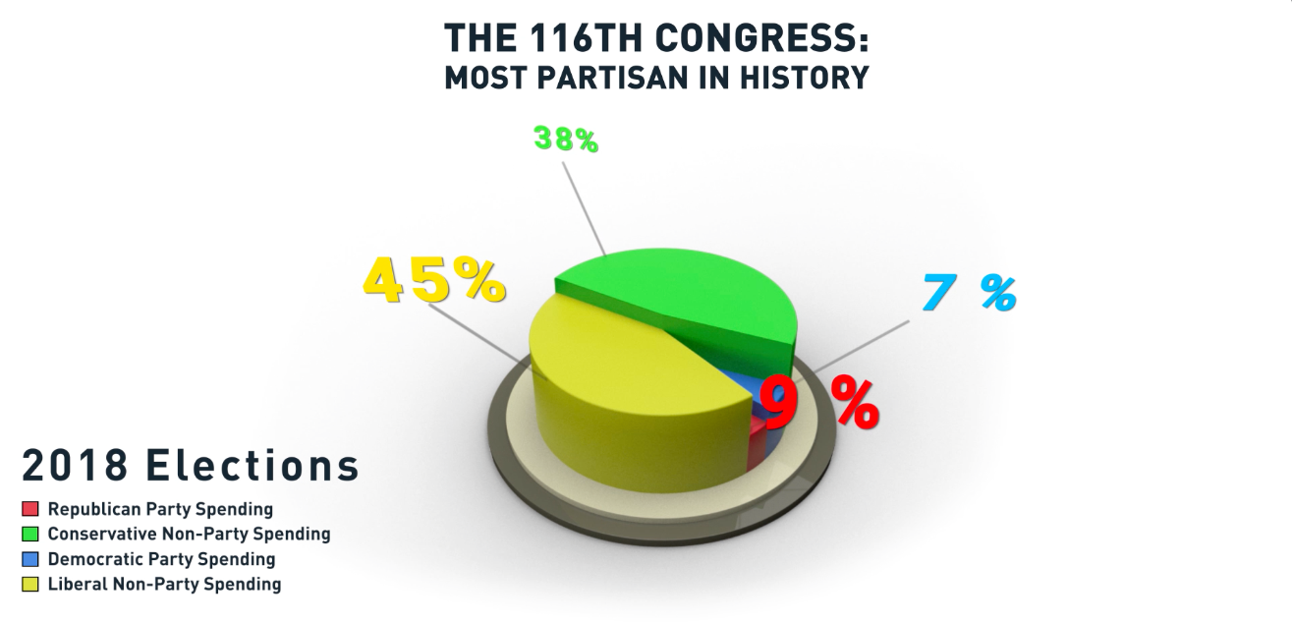
American Subcontractors Association
www.asaonline.com | www.subexcel.com | http://contractorscompass.org

Slide 6
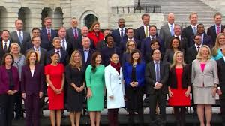
U.S. House
American Subcontractors Association
www.asaonline.com | www.subexcel.com | http://contractorscompass.org

Slide 7
American Subcontractors Association
www.asaonline.com | www.subexcel.com | http://contractorscompass.org

Slide 8
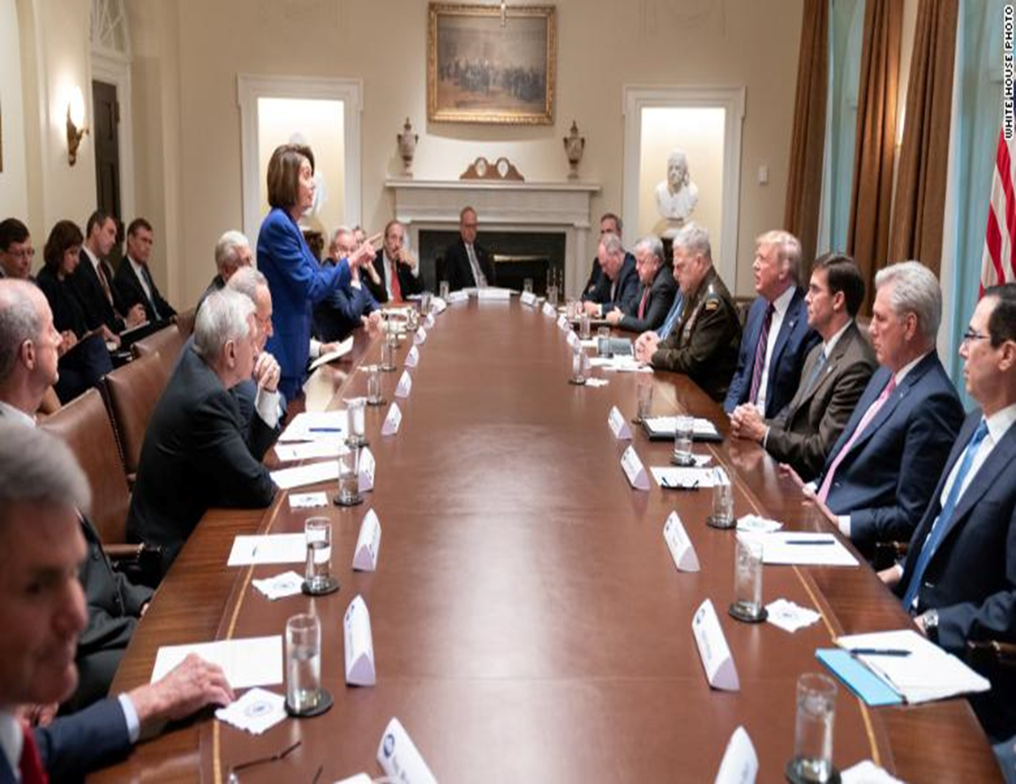
October 15, 2019 : White House Syria Meeting
American Subcontractors Association
www.asaonline.com | www.subexcel.com | http://contractorscompass.org

Slide 9
Revitalizing the Federal Courts
The Senate and President Trump
In 2013, former Democratic Majority Leader Reid ended the filibuster on judicial nomination votes.
Supreme Court Justices: Neil Gorsuch and Brett Kavanaugh
Senate confirmed 187 federal judges to the federal bench in the last three years.
Including 50 judges to the federal circuit court of appeals
In 2017, when President Trump took office, Democratic appointees made up the majority on nine of the 13 circuit courts.
In 2020, President Trump’s appointments flipped three circuit courts:
2nd (NY, VT, CT)
3rd (DE, NJ, PA)
11th (FL, GA, AL)
In total, seven circuits have Republican majority appointees.
American Subcontractors Association
www.asaonline.com | www.subexcel.com | http://contractorscompass.org

Slide 10
South Carolina Congressional Delegation
Sen. Graham (R)
Committees
Judiciary (Chair)
Appropriations
Budget
Sen. Scott (R)
Committees
Banking
Housing
Finance
Health, Education, Labor & Pensions
Small Business
7 Congressional Districts
American Subcontractors Association
www.asaonline.com | www.subexcel.com | http://contractorscompass.org

Slide 11
The 2020 Election
American Subcontractors Association
1004 Duke St., Alexandria, VA 22314
www.asaonline.com | www.subexcel.com | http://contractorscompass.org

Slide 12
Impeachment
American Subcontractors Association
www.asaonline.com | www.subexcel.com | http://contractorscompass.org

Slide 13
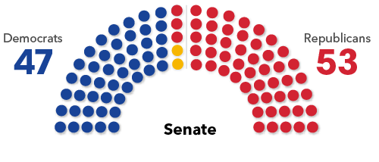
Senate Balance of Power
Trump’s re-election outlook and each party’s ability to field strong candidates are key
If Democrats net four seats they would take control of the Senate; netting three seats would result in a tie and the majority would be decided by the vice president’s party
If either Elizabeth Warren or Bernie Sanders were the Democratic presidential nominee and defeated Trump then the GOP governor of their state would be in a position to name an interim senator of their choosing until a special election could be held
Democrats last defeated more than two Republican senators in 2008, when Barack Obama’s victory helped Democrats beat five GOP incumbents
Senate Balance of Power
Source: Bloomberg Government
Note: Yellow reflects independents who caucus with Democrats

Slide 14
Senate 2020 Forecast
Solid Democratic
Solid Republican
Toss up
Likely Democratic
Likely Republican
No race
Lean Democratic
Lean Republican
Wash.
Mont.
Maine
N.D.
Vt.
Ore.
Minn.
N.H.
Idaho
S.D.
Wis.
N.Y.
Mass.
Wyo.
Mich.
R.I.
Pa.
Conn.
Neb.
Iowa
N.J.
Nev.
Ill.
Ind.
Ohio
Del.
Utah
W.Va.
Md.
Calif.
Colo.
Kan.
Va.
Mo.
Ky.
Tenn.
N.C.
Ariz.*
Okla.
Ark.
S.C.
N.M.
Miss.
Ala.
Ga.*
Texas
La.
Alaska
Fla.
Hawaii
Source: Race ratings from Cook Political Report; as of Jan. 10
Note: Georgia has one regularly scheduled election and one special election; Arizona has one special election

Slide 15
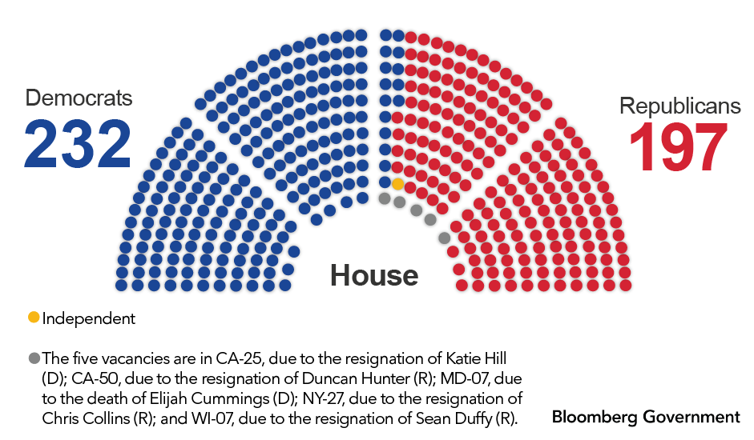
Big Picture on 2020 House Races
All 435 House seats are up in 2020
Democrats are defending their majority after a net gain of 40 seats in 2018 election
Republicans would need to net around 18 seats to flip the chamber
Some of the most closely watched races will be districts won by the other party’s 2016 presidential candidate

Slide 16
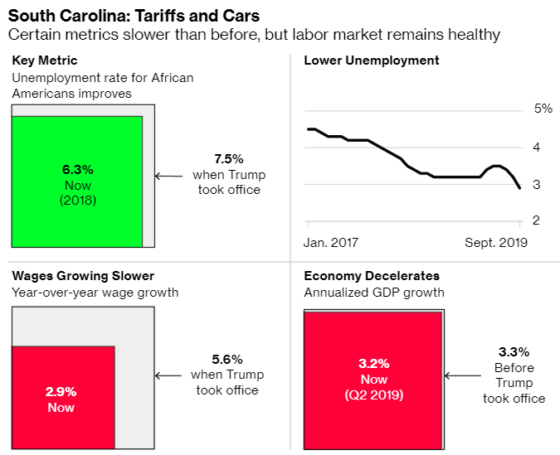
Early Voting State Economies: South Carolina
Date of Democratic Primary: Feb. 29
2016 Vote: Trump 54.9%, Clinton 40.7%
South Carolina is one of the largest exporters of cars in the U.S and its manufacturing sector employs about a tenth of non-farm jobs.
Despite being particularly exposed to Trump’s protectionist trade policies, its economy is also growing. Germany’s BMW and Mercedes-Benz, Japan’s Honda, Sweden’s Volvo and the nation’s largest airplane maker, Boeing, each have facilities in the state.
The unemployment rate among African Americans dropped to 6.3% in 2018 from 7.5% in 2016. That’s important for Democrats because the group made up about 60% of Democratic voters in 2016.
ECONOMIST TAKE: “In South Carolina, to the average consumer, the data would suggest that things are looking pretty good right now,” said Joey Von Nessen, a research economist at the University of South Carolina. “Consumers are looking at three things: jobs, incomes and prices.”
Sources: Department of Commerce, Bureau of Labor Statistics
Note: “Now” figure is latest available. Trump took office in January 2017

Slide 17
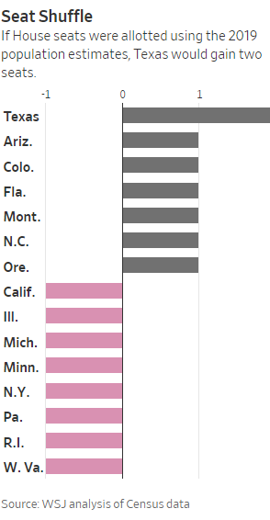
Population Shift Helps South and Southwest
New state census totals show population continuing to shift from the North and Midwest to the South and Southwest
The results of the 2020 census will determine the new distribution of House seats and Electoral College votes by December 2020. The first elections likely to be affected by the seat changes will be in 2021. Most states will redraw congressional and legislative districts in time for 2022 votes.
The latest data reflect sweeping changes across the U.S. since the start of the decade:
Americans are getting older and having fewer babies;
Immigration is slowing, and the rate at which people move between states is at its lowest level in decades; and
Those who do uproot are often leaving the Northeast and Midwest for warmer places in the Sunbelt and pockets of the West because of their favorable weather, strong job growth, cheaper housing and, in some cases, lower taxes.
American Subcontractors Association
www.asaonline.com | www.subexcel.com | http://contractorscompass.org

Slide 18
Four Non-Campaign Stories to Watch in 2020
Democracy Protests in Hong Kong
The breath and durability of the pro-democracy protests against the world’s most powerful authoritarian government in China are remarkable.
North Korea’s Weapons
For two years, President Trump and North Korean Leader Kim Jong Un have embraced an uneasy and temporary understanding: the U.S. would vaguely promise an eventual end to economic pressure, and in return North Korea would stop its missile and nuclear programs and vaguely promise to denuclearize.
Iran
President Trump’s efforts to increase economic pressure on the clerical regime in Tehran have been extremely successful.
Brexit
British Prime Minister Boris Johnson appears to have the political strength to push it through in 2020!
American Subcontractors Association
www.asaonline.com | www.subexcel.com | http://contractorscompass.org

Slide 19
ASA Task Force on Government Advocacy
American Subcontractors Association
1004 Duke St., Alexandria, VA 22314
www.asaonline.com | www.subexcel.com | http://contractorscompass.org

Slide 20
2019 Legislative Accomplishments
S. 1434: Banning reverse auction in construction services unanimously passed in the Senate 100-0.
Cadillac Tax: President Trump signed the law for the full repeal of the 40% excise tax on high-cost health plans (the "Cadillac Tax").
529 Apprenticeship Savings Accounts: Setting Every Community Up for Retirement Enhancement (SECURE Act), which takes effect on January 1, 2020:
expands 529 education savings accounts to cover registered apprenticeships; homeschooling; up to $10,000 of qualified student loan repayments (including for siblings); and private elementary, secondary, or religious schools.
American Subcontractors Association
1004 Duke St., Alexandria, VA 22314
www.asaonline.com | www.subexcel.com | http://contractorscompass.org

Slide 21
2019 Legislative Accomplishments
2020 National Defense Authorization Act (NDAA)
ASA supported the following NDAA provisions included in the Act:
Sec. 806 - Standardizing data collection and reporting on use of source selection procedures by federal agencies
Sec. 873 - Accelerated payments applicable to contracts with certain small business concerns under the Prompt Payment Act
Sec. 872 - Reauthorization and improvement of Department of Defense Mentor-Protege Program
Sec. 874 - Postaward explanations for unsuccessful offerors for certain contracts
American Subcontractors Association
1004 Duke St., Alexandria, VA 22314
www.asaonline.com | www.subexcel.com | http://contractorscompass.org

Slide 22
2020 Legislative Priorities
H.R. 5247: SUBS Act – Bid Listing
H.R. 2344: Change Orders
S. 1434: Reverse Auction in the House
Miller Act – Bonding Requirements
P3 Bonding Requirements in TIFIA (Transportation Infrastructure Finance + Innovation Act)
American Subcontractors Association
1004 Duke St., Alexandria, VA 22314
www.asaonline.com | www.subexcel.com | http://contractorscompass.org

Slide 23
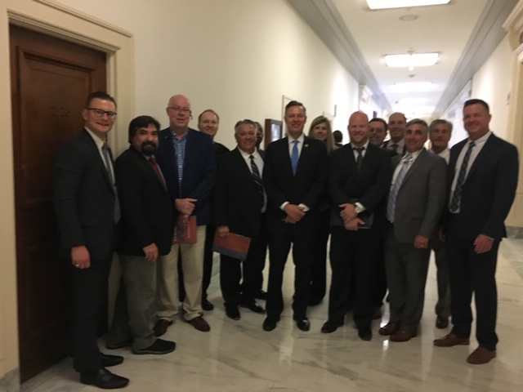
American Subcontractors Association
www.asaonline.com | www.subexcel.com | http://contractorscompass.org

Slide 24
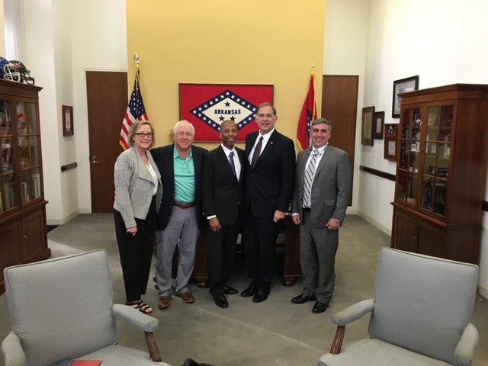
American Subcontractors Association
www.asaonline.com | www.subexcel.com | http://contractorscompass.org

Slide 25
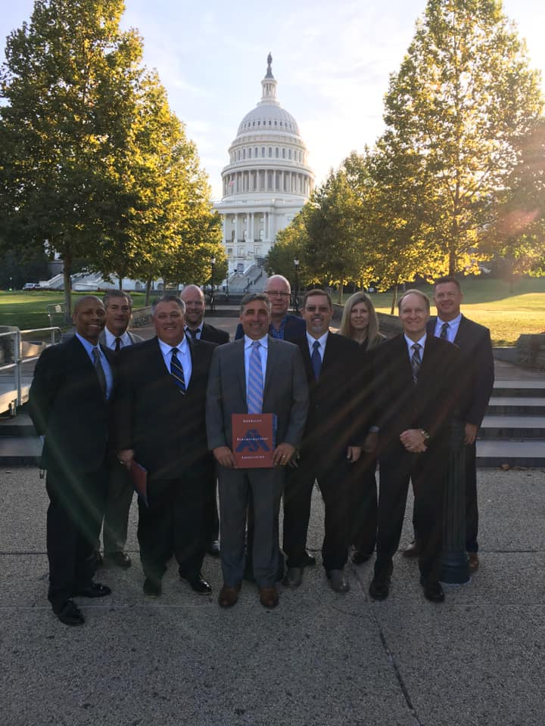
2020 Legislative Fly-In June 9-10, 2020
American Subcontractors Association
www.asaonline.com | www.subexcel.com | http://contractorscompass.org

Slide 26
Regulatory Update – Unfair Competition
Government Accountability Office (GAO) begins auditing the Federal Prison Industries (FPI) authorized by Congress with the passage of the FIRST STEP Act of 2018 (P.L.115-391) signed into law on December 21, 2018.
ASA meets with GAO on August 29, 2019 and these are the questions posed:
Please identify the challenges, if any, private companies face in competing with FPI.
FPI’s sales have declined when compared to the early 2000s. Has the extent of the burden, if any, FPI places on the private sector declined commensurately?
Please identify those elements of prior reform efforts that remain relevant today.
What are the primary differences in the cost structure between FPI and private sector (non-profit, as applicable) producers and how are these differences reflected in product prices?
To what extent have you analyzed the effect of the First Step Act’s expansion of markets available to FPI? Are there any recent analyses of FPI of which we should be aware?
American Subcontractors Association
1004 Duke St., Alexandria, VA 22314
www.asaonline.com | www.subexcel.com | http://contractorscompass.org

Slide 27
Regulatory Update – Silica
ASA is a member of the Construction Industry Safety Coalition (CISC)
The Silica Request for Information (RFI) was officially published in the Federal Register: https://www.govinfo.gov/content/pkg/FR-2019-08-15/pdf/2019-17450.pdf. Comments are due October 15, 2019.
ASA, along with the CISC, is responded to the 31 questions OSHA asked regarding the effectiveness of dust control methods not currently included in Table 1 of the silica in construction standard.
American Subcontractors Association
1004 Duke St., Alexandria, VA 22314
www.asaonline.com | www.subexcel.com | http://contractorscompass.org

Slide 28
Subcontractor Legal Defense Fund
Activity Report
By Shannon Oscar
Managing Director, ASA Task Forces
American Subcontractors Association
American Subcontractors Association
1004 Duke St., Alexandria, VA 22314
www.asaonline.com | www.subexcel.com | http://contractorscompass.org

Slide 29
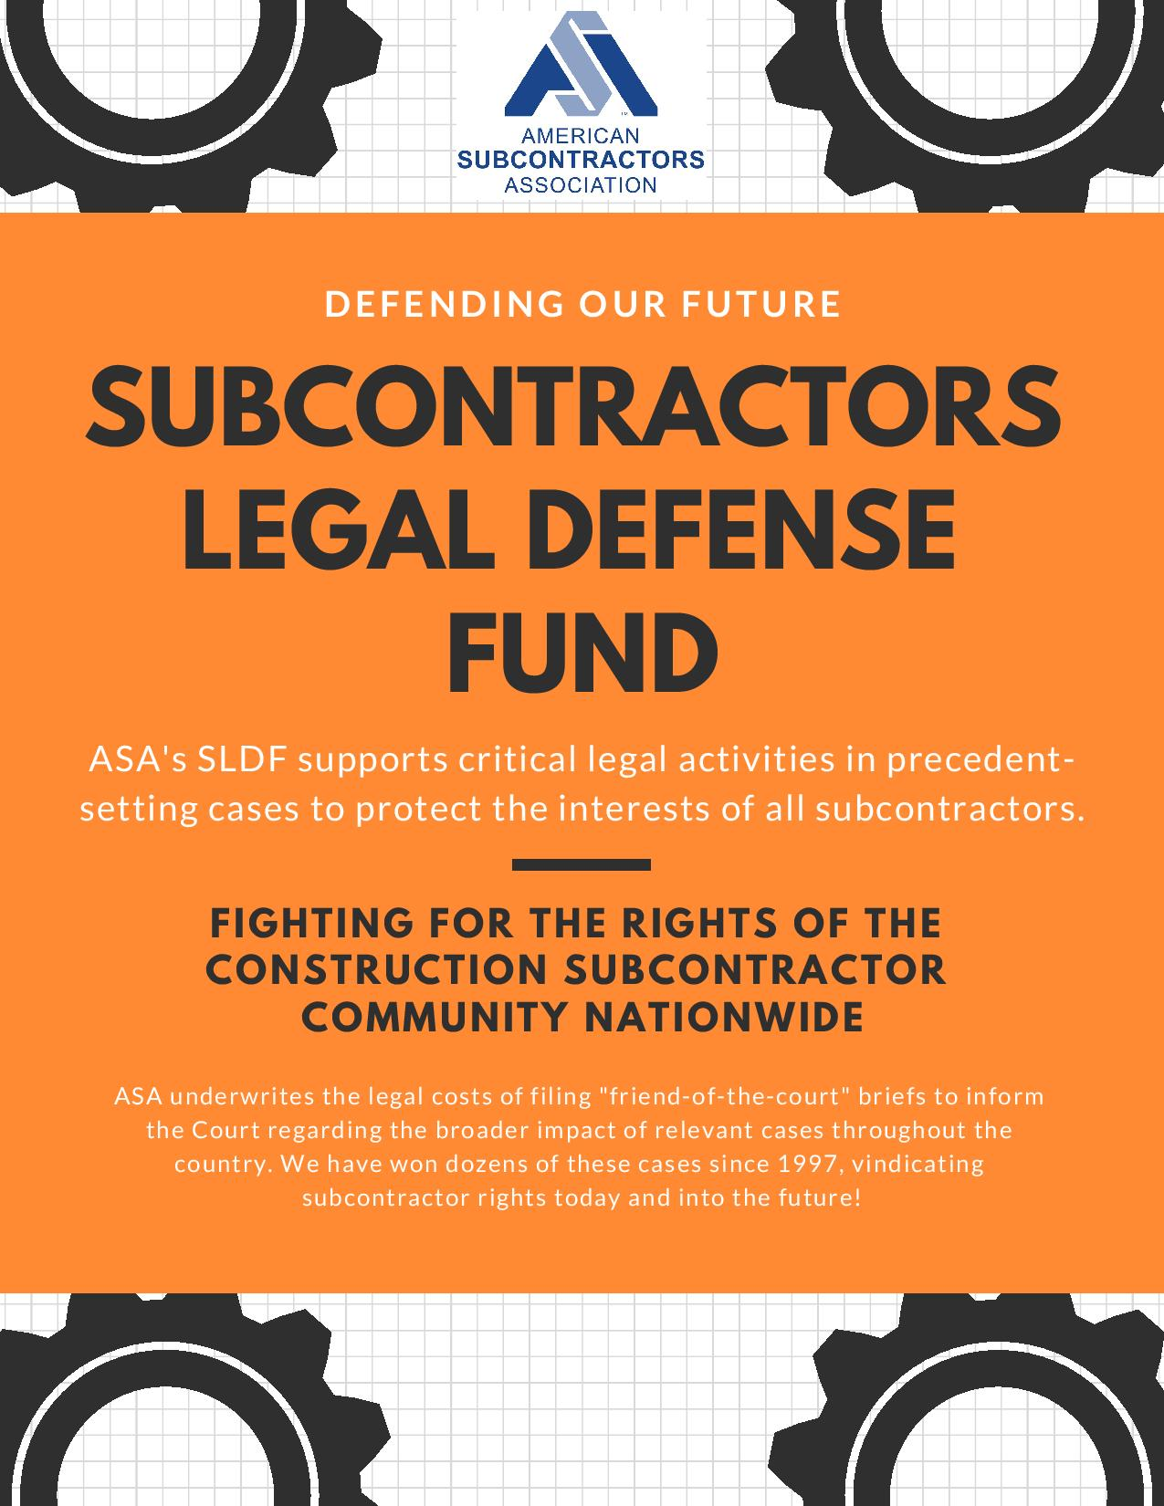
American Subcontractors Association
www.asaonline.com | www.subexcel.com | http://contractorscompass.org

Slide 30
Snake Steel, Inc. v. Holladay Construction, Inc.
The subcontractor (the Sub) is appealing a trial court decision under the Tennessee Prompt Pay Act (TPPA).
The dispute arose out of $15 million construction project between the owner, GC, and the Sub, Snake Steel, Inc.
On 10/24/14, the Sub completed the work, and the GC paid the sub except for a change order and the 5% retainage amount.
Owner paid the retainage to the GC, but the GC neither passed the retainage amount to the Sub or deposited it into an escrow account as per TPPA.
After three years of not receiving full payment, the Sub was paid by the GC without realizing the Sub’s right to claim for interest, attorneys fees, plus $300.00, which is a TPPA requirement, if the retainage holder (the GC) failed to open an escrow account.
The trial court claimed the Sub time barred by the one year statute of limitations and the Sub’s claim accured when it billed for the retainage more than one year before filing suit.
In 2/16, the Sub invoiced GC for final payment (retainage + change order).
On 9/25/17, the Sub still not paid, but filed a compliant against the GC.
In 12/17, the Sub paid in full.
American Subcontractors Association
www.asaonline.com | www.subexcel.com | http://contractorscompass.org

Slide 31
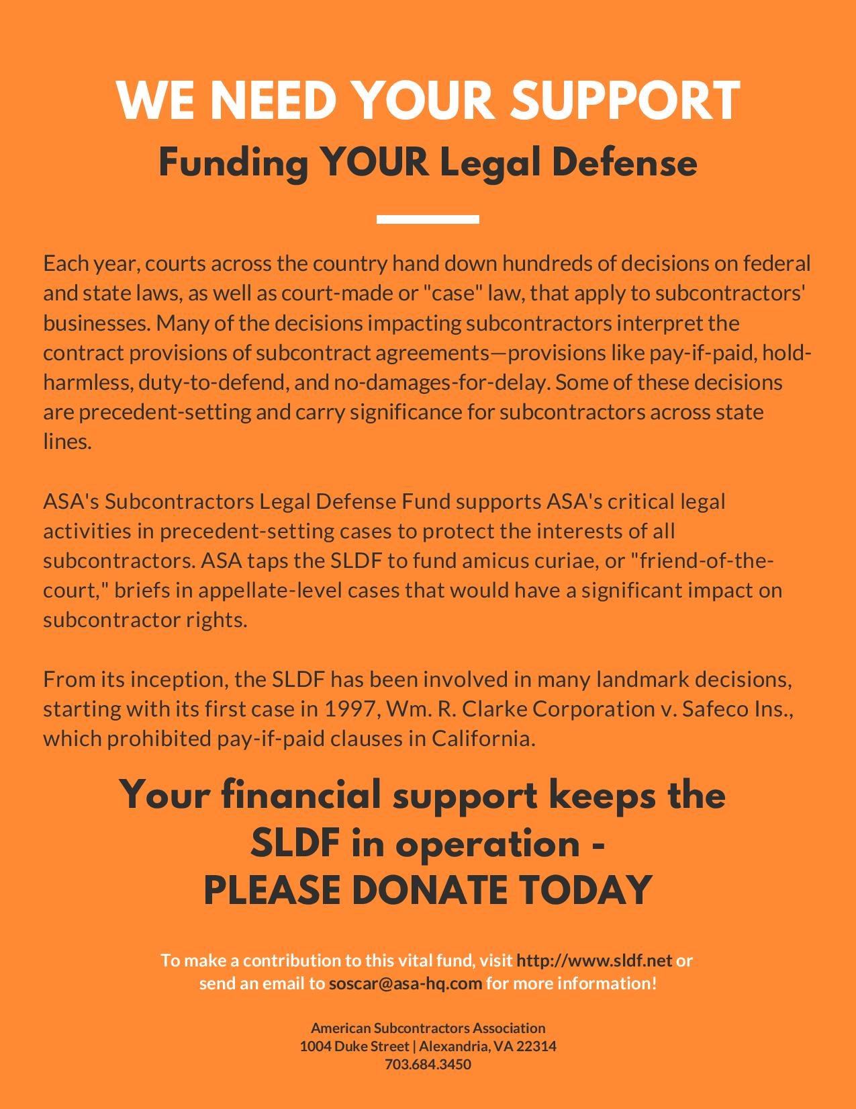
American Subcontractors Association
www.asaonline.com | www.subexcel.com | http://contractorscompass.org

Slide 32
State Chapter Voter Voice
Activity Report
By Timothy Ward
Government Relations Communications Director
American Subcontractors Association
American Subcontractors Association
1004 Duke St., Alexandria, VA 22314
www.asaonline.com | www.subexcel.com | http://contractorscompass.org

Slide 33
ASA Chapter | Date | Legislative Topic | Position | # of ASA Participants | Bill Status
ASA of Tennessee | 2/20/19 | Retainage; Stop Work; Ban pay-if-paid clauses | Support | 45 | Pending
ASA of Oklahoma | 3/11/19 | Retainage; Construction procurement | Support | 20 | Enacted May 15, 2019
ASA of Texas | 3/15/19 | Bans local employment ordinances | Support | 13 | Pending
ASA of Metro Washington | 4/2/19 | Retainage | Support | 9 | Enacted April 30, 2019
ASA of Texas | 4/22/19 | Construction Defect Litigation; Right-to-Repair; Attorney fee loophole | Support | 74 | Construction Defect and Right-to-Repair legislation enacted June 14, 2019
ASA of Texas | 4/26/2019 | Uniform statewide employment regulations | Support | 29 | Pending
 |  |  | Total: | 190
*ASA of Texas includes ASA of North Texas, San Antonio and Houston
American Subcontractors Association
www.asaonline.com | www.subexcel.com | http://contractorscompass.org

Slide 34
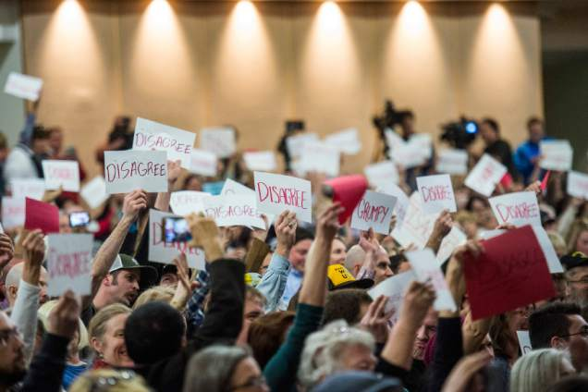
Engaging Legislators
The Political / Legislative Consequences of Acting Versus Not Acting
Engaging Legislators and their District and Legislative Staffers
Understanding the Advantages and Disadvantages of Different Means of Contact (Meetings compared to phone calls, letter, emails, and political activities.)
Follow Up and Ask For a Specific Commitment
Organize Events
Tell Your Story
Thank You
Develop a Timeline for Advocacy
American Subcontractors Association
www.asaonline.com | www.subexcel.com | http://contractorscompass.org

Slide 35
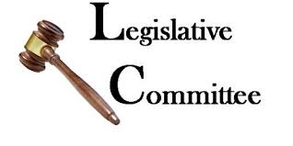
Develop: ASA Chapter Legislative Committee
As a Legislative Committee Member, you will help the Chapter:
Develop official stances on hot-button political issues
Raise funds for our state and federal Political Action Committees
Plan and execute the State Advocacy Day and related events
Improve relationships with our local, state, and federal representatives
Encourage other Members to participate in the Chapter Legislative Committee
Participation in Committee activities should be voluntary; you will never be required to attend a meeting, conference call, or other Committee event
American Subcontractors Association
www.asaonline.com | www.subexcel.com | http://contractorscompass.org

Slide 36
Thank You
Comments / Questions?
American Subcontractors Association
1004 Duke St., Alexandria, VA 22314
www.asaonline.com | www.subexcel.com | http://contractorscompass.org

Slide 37
American Subcontractors Association
www.asaonline.com | www.subexcel.com | http://contractorscompass.org

